Slide 1
MS Access
Lab 30: Primary Key, Foreign Key, Relationship

Slide 2


Welcome to MS Access Class

Slide 3

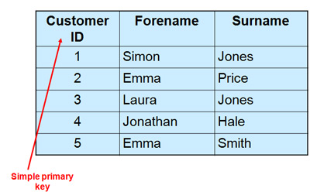
What is Primary Key?
The PRIMARY KEY constraint uniquely identifies each record in a database table.
Primary keys must contain UNIQUE values, and cannot contain NULL values.
A table can have only one primary key, which may consist of single or multiple fields.

Slide 4
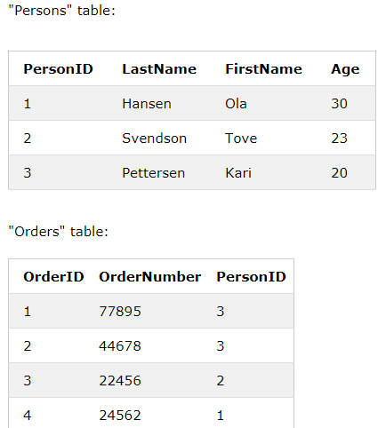
What is Foreign Key?
A FOREIGN KEY is a key used to link two tables together.
A FOREIGN KEY is a field (or collection of fields) in one table that refers to the PRIMARY KEY in another table.

Slide 5
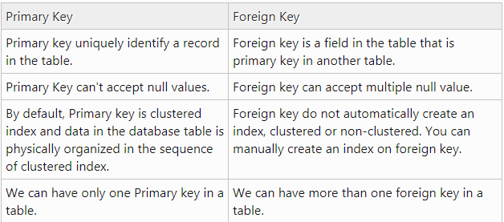
Primary Key vs. Foreign Key

Slide 6
What is Relationship?
A relationship (in Database) is a situation where multiple tables can contain related data that is linked by a common field.
A relationship consists of a parent table and a child table.

Slide 7
Table
Types of Relationship

Slide 8
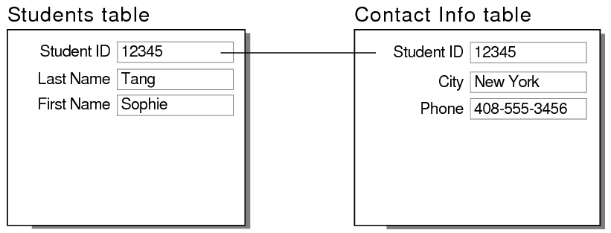
Relationship
2. One-to-One
A row in table A can have only one matching row in table B, and vice versa.

Slide 9
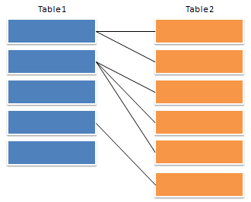
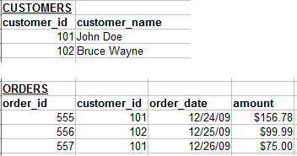
Relationship
2. One-to-Many (or Many-to-One)
A row in table A can have many matching rows in table B, but a row in table B can have only one matching row in table A.

Slide 10
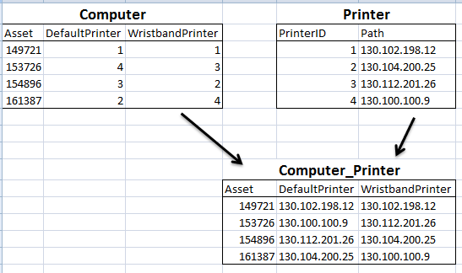
Relationship
2. Many-to-Many
A row in table A can have many matching rows in table B, and vice versa. This is achieved through the use of a third table (commonly called a junction table) that contains lookup data for both tables.

Slide 11

Thank You!

